Slide 1
Hall Effect Experiment
EXPEERIMENT 1
Engineering Physics Laboratory
Dr. Sarathlal K V
Department of Physics
SOE, UPES
+91 9845747350

Slide 2
Hall effect EXPERIMENT
AIM:
To study the Hall Effect and hence determine the Hall coefficient (R_{H}) and carrier density (n) of a given semiconductor.

Slide 3
Schematic
APPARATUS:
Hall Probe (Ge Crystal) (thickness=0.4-0.5 mm); Hall Probe (InAs crystal), Hall Effect set-up, Digital mill voltmeter (0-200 mV), a constant current power supply and an electromagnet (Field intensity (11,000±5 % Gauss)

Slide 4
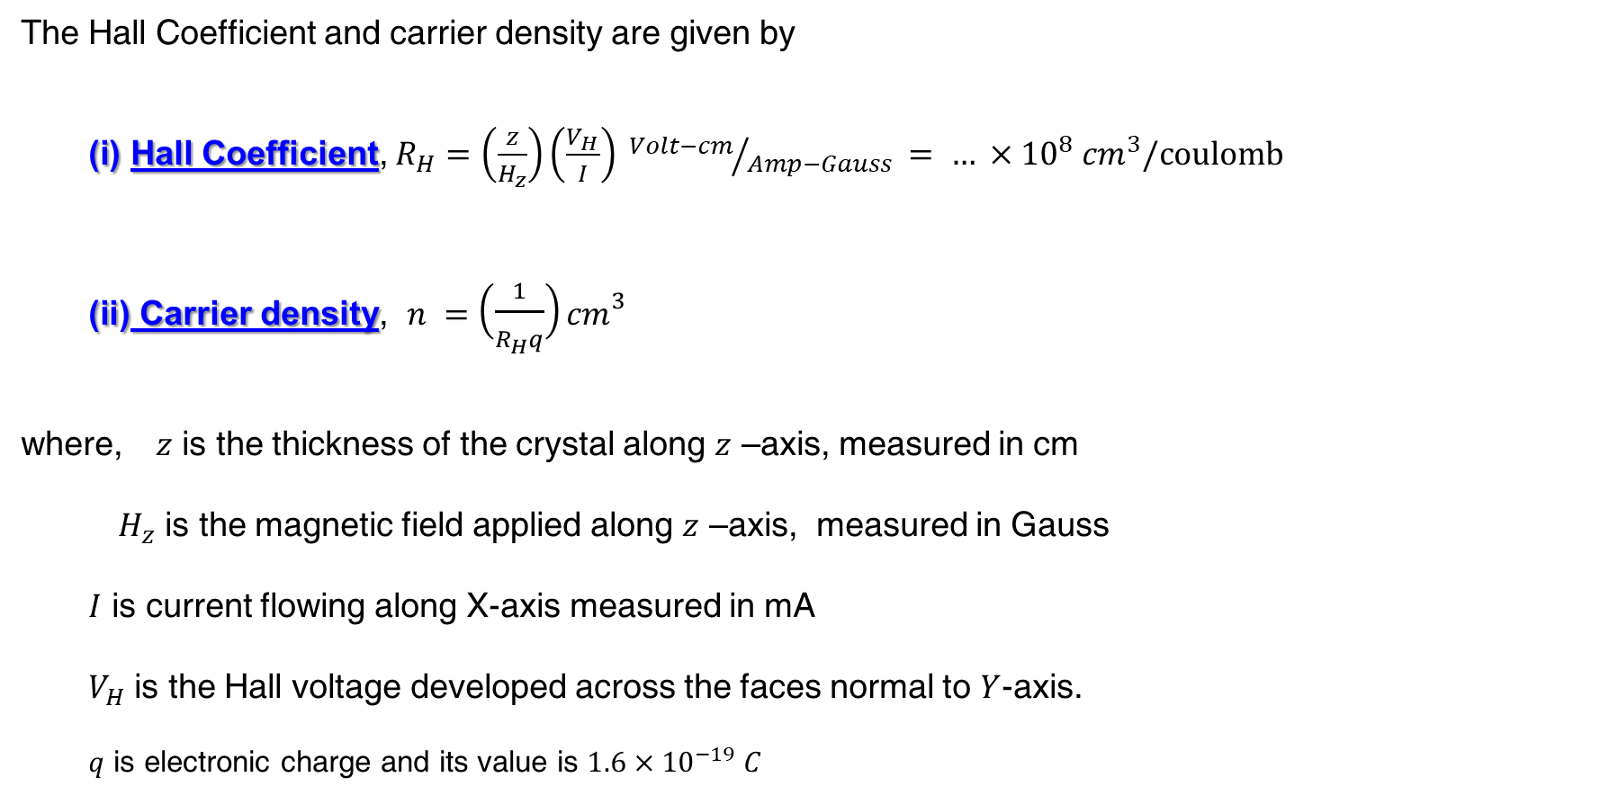
FORMULA:
The Hall Coefficient and carrier density are given by
Hall Coefficient, $R_{H}=\left(\frac{z}{H_{z}}\right)\left(\frac{V_{H}}{I}\right) {Volt−cm}/{Amp−Gauss} = … ×{10}^{8} {cm}^{3}/coulomb$
Carrier density, $n =\left(\frac{1}{R_{H}q}\right){cm}^{3}$
where, $z$ is the thickness of the crystal along $z$ –axis, measured in cm
$H_{z}$ is the magnetic field applied along $z$ –axis, measured in Gauss
$I$ is current flowing along X-axis measured in mA
$V_{H}$ is the Hall voltage developed across the faces normal to $Y$-axis.
$q$ is electronic charge and its value is $1.6×{10}^{−19} C$

Slide 5
VIRTUAL Experiment

Slide 6
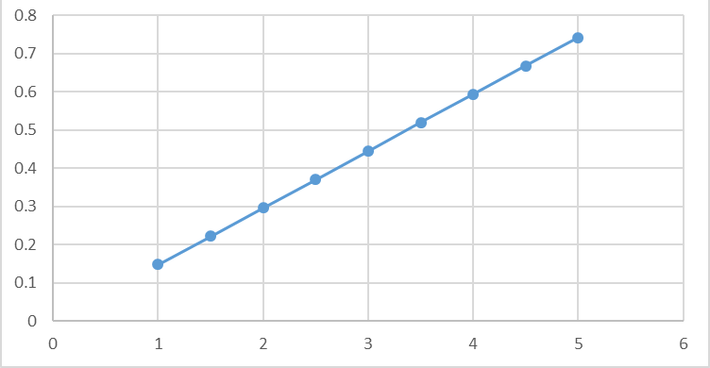
Observation Table I
Current Vs Magnetic Field
Trial No: | Current through solenoid | Magnetic field generated
1 | 1
2 | 1.5
3 | 2
4 | 2.5
5 | 3
6 | 3.5
7 | 4
8 | 4.5
9 | 5
Magnetic Field (Gauss)
Current (A)

Slide 7
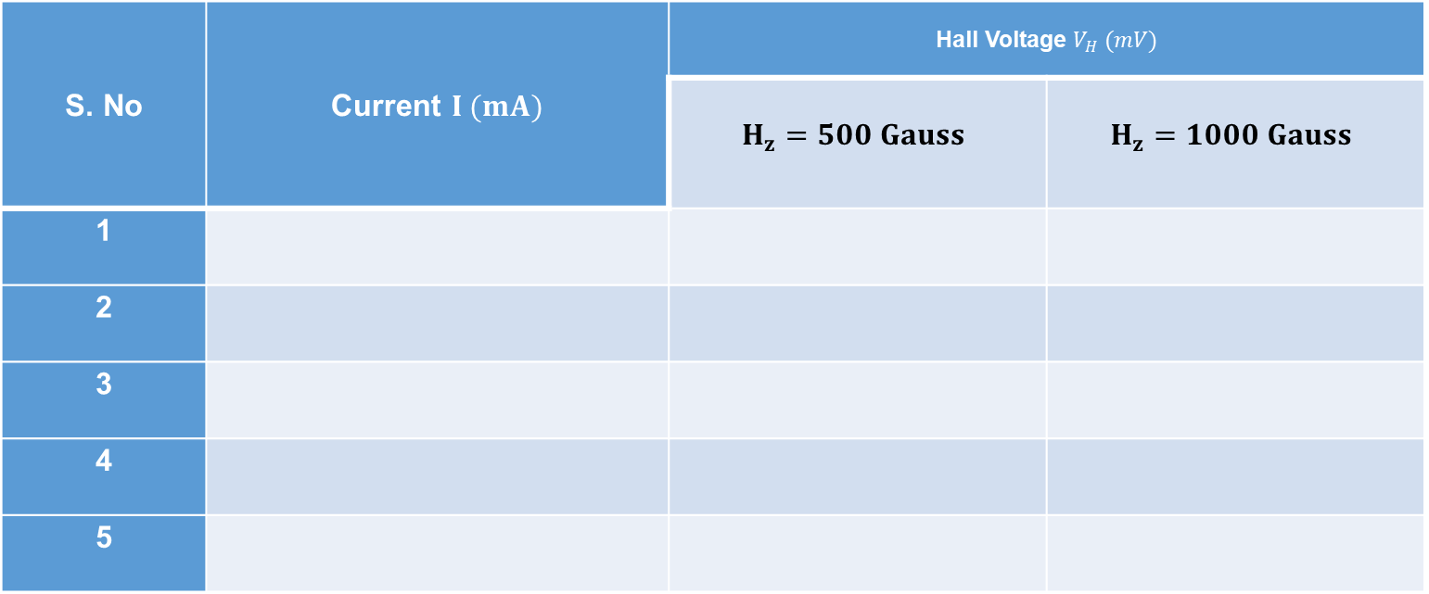
Observation Table I
Thickness of the semiconductor crystal, z=0.5 mm=0.05 cm
S. No | Current $I (mA)$ | Hall Voltage $V_{H} (mV)$
 |  | $$H_{z}=500 Gauss$$ | $$H_{z}=1000 Gauss$$
1
2
3
4
5

Slide 8
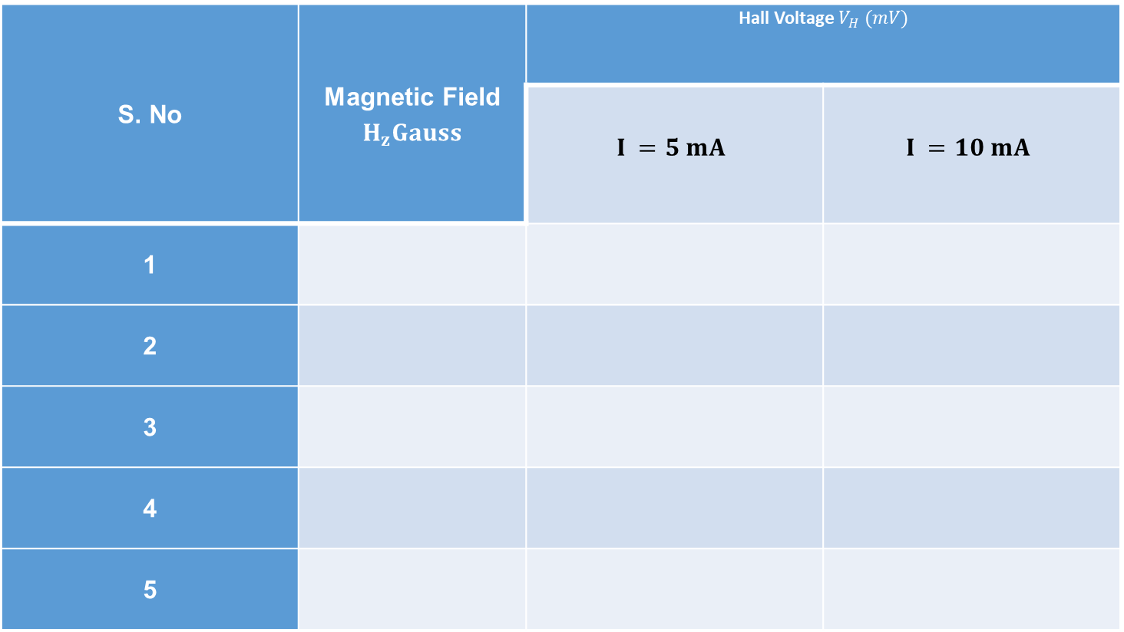
Observation Table II
S. No | Magnetic Field $H_{z}Gauss$ | Hall Voltage $V_{H} (mV)$
 |  | $$I =5 mA$$ | $$I =10 mA$$
1
2
3
4
5

Slide 9






GRAPHS
$$H_{z}=1000 Gauss$$
$$I =10 mA$$
Hall Voltage $V_{H} (mV)$
Hall Voltage $V_{H} (mV)$
I =5 mA
Hz=500 Gauss
Current, $I (mA)$
Magnetic Field, $H_{z}$ $(Gauss)$
Figure. Plot of V_{H} (mV) versus I
Figure. Plot of VH (mV) versus Hz

